Slide 1
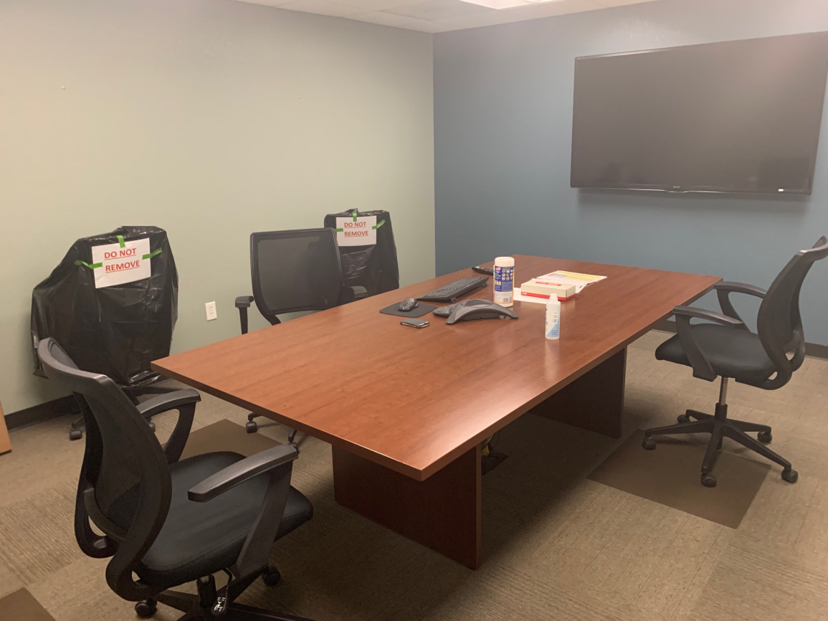
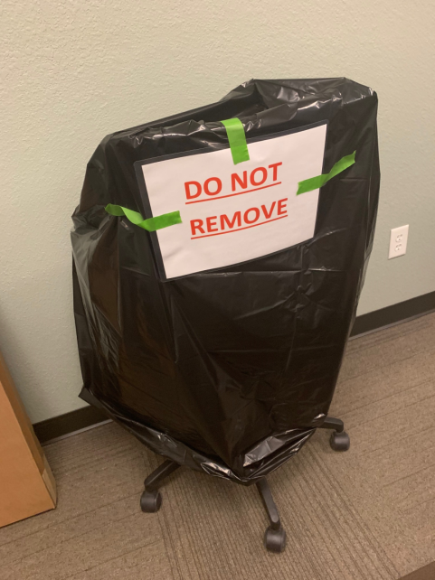
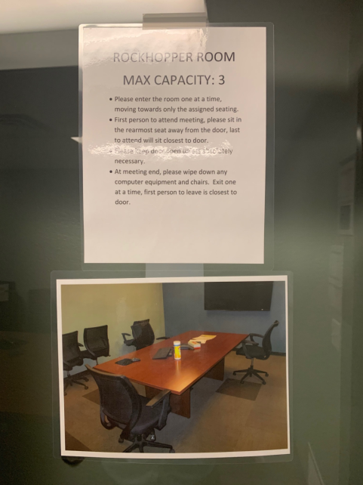
Safeguarding Conference Rooms
Limit the number of people who can be in the conference room
Physically space seating out to provide 6’ of safe distancing
Cover extra chairs with a black garbage bag to help prevent people from using the extra chairs and not following the 6’ guidelines
Post conference room expectations on the door (sample provided on following slides)
Create a cleaning checklist for the conference room participants to execute when their meeting is over (sample provided on following slides)

Slide 2
INSERT NAME OF CONFERENCE ROOM
MAX CAPACITY: X
Please enter the room one at a time, moving towards only the assigned seating.
First person to attend meeting, please sit in the rearmost seat away from the door, last to attend will sit closest to door.
Please keep door open unless absolutely necessary.
At meeting end, please wipe down any computer equipment and chairs. Exit one at a time, first person to leave is closest to door.

Slide 3
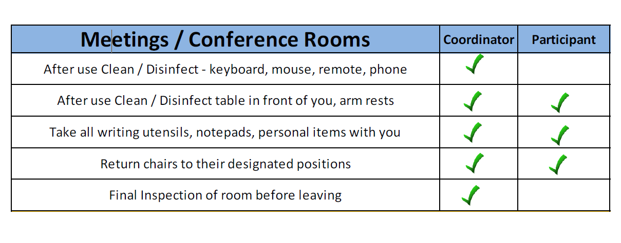
PUT A LAMINATED CLEANING CHECKLIST IN EACH CONFERENCE ROOM AS A REMINDER OF WHAT NEEDS TO BE CLEANED WHEN A MEETING IS OVER AND WHOSE RESPONSIBILITY IT IS

